Slide 1
Javascript
its new natural habitat everywhere
Notes:
Thank you for coming back!
Last talk JS in the browser.
Last week the web platform.
Much of its life only in browser
So to run it:
browser console
create a web app
clever websites such as jsbin
then this happened…
https://www.youtube.com/watch?v=ztspvPYybIY
3 mins (3)

Slide 2
“… It’s a rather large C project actually ...”
Ryan Dahl, 2009
https://youtu.be/ztspvPYybIY?t=7
Notes:
‘it confuses a lot of people’
https://www.youtube.com/watch?v=ztspvPYybIY
container for js – just like a browser
choice between Ryan and me…
content is gold
3 mins (6)

Slide 3
Systems Application
operating systems
database engines
file servers
device drivers
routers
browsers
anything that answers business requirements
Notes:
os
db
file server
device driver
routers
might surprise you – come back to this – browsers -
application
– know what is but struggle for definition
- initially anything involving UX
miss out middleware
so: anything that answers business requirements
1 mins (7)

Slide 4


Node
Your Javascript code
application
system
V8 compiler
libuv
Notes:
whereas a browser handles IO and draws UI’s and JS is a supporting technology
in node, components are there to support js
V8 compiler – Google, same as chrome
libuv – IO abstraction over network & file, plus thread pool, DNS, signals etc.
here why 1 reason why such a success
straddles system and application programming
unicorn velociraptor library – geeks
2 mins (9)

Slide 5
demo
node01/process_hello.js
node02/console_hell0.js
node03/report.js
Notes:
time for a demo – don’t get too excited
show 3 examples
simpler than in browser!
go through flow of processing
beyond spanning app/system divide, three key features that have made node a success
first a sidebar…
I want to talk about fast things
faster, in fact fastest light in vacuum
Edinburgh – New York 50x
3 GHz one clock cycle > 10 cm
4 mins (13)

Slide 6
IO: relative speeds
if processor = 1 second
then disk = days
network = weeks
Notes:
IO = Input Output, getting data to the processor
disparity between processor speeds
influences much if not all software design
Ryan Dahl called it ‘the problem of IO’
“IO bound”
apache – threads – difficult to define
Thead == process: gross, misleading simpolification
99.999% of time doing nothing
3 mins (16)

Slide 7
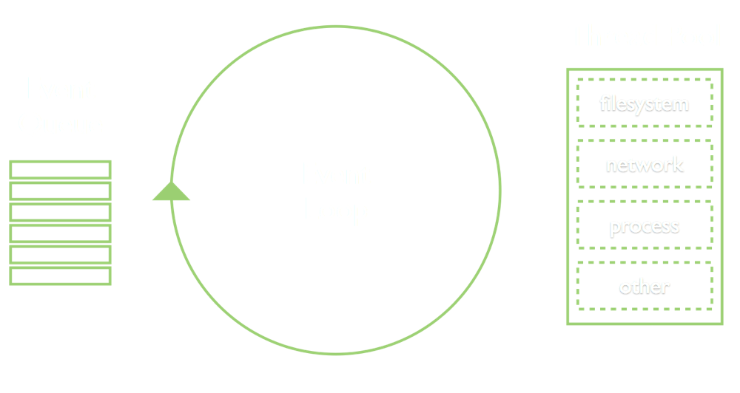
1: Event Loop
Notes:
another model
another gross simplification!
instead of 1000’s of threads – you have 1
performance & scalability
not unique to Node – webservers: nginx, vertx
language Ruby – eventmachine, Python - twisted
also in fact, familiar to UI programmers of any language
standard way of working
3 mins (19)

Slide 8
demo
node04/directory_listing.js
node05/directory_listing_X.js
Notes:
demo
ignore require
first class functions, closure – JS perfect fit
Ryan Dahl says reason for choosing JS
finally, for techies, above slide is conceptually correct, but technically wrong…
4 mins (23)

Slide 9

https://medium.com/the-node-js-collection/what-you-should-know-to-really-understand-the-node-js-event-loop-and-its-metrics-c4907b19da4c
https://www.youtube.com/watch?v=PNa9OMajw9w
Notes:
side note: techies only
libuv – thread pool of 4!
conceptually correct but
most async IO not on threads
1 min (24)

Slide 10
2: Modules
node02/console_hello.js
node02a/console_hell0.js
node04/directory_listing.js
Notes:
Breaking large lumps of code into smaller units
Javascript has no language specific modularisation, unlike static languages
In true JS fashion commonjs, amd, umd
Node settled on one, commonjs, decorated it a little
standardised it
demo
ironically now es6 (latest Javascript), node a laggard
5 mins (29)

Slide 11
3: Node Package Manager (npm)
node06/server.js
Notes:
‘require’ - own code, node code, third party code
add on tool added a year or so after initial Node
makes bringing in modules trivial
create node06 with express
can do as quickly in other languages – but size of npm repo + combining with own code + other assets
example of real code – surface server.js
the bad - simplicity hide problems – directory depth with transitive dependencies / determinism
too easy? mash-up style of programming: left-pad March 2016
5 mins (34)

Slide 12
Javascript : a reasonable application language
a container that bridges system and application programming
event loop : a structured programming model
common.js / es6 : built-in modularisation
npm : huge library of easily used components
=> Productivity
Notes:
5 elements
most productive coding environment I have worked in
actually a sixth element, node permits JS ubiquity
to illustrate...
2 mins (36)

Slide 13
Notes:
least annotated diagram you have seen - security, security
orientation funny: start at right, clients
web ‘leaf’ servers’
intermediate servers – stateless, microservices
off to left systems land
bottom, developer machine - tools
what technologies to use...
2 mins (39)

Slide 14


Notes:
client – browser
servers – event model great for stateless
network & file IO essentially same form computer’s point of view
node tools to write node servers to serve javascript clients
all application programming
‘full stack’ - a single language, common programming model
might be a surprise to non-techies
always other choices, but compelling for
devs, companies, etc.
2 mins (41)

Slide 15
Javascript
its new natural habitat everywhere
Notes:
hence the title
use Lloyds as an example
1 min (42)

Slide 16
Notes:
Labs – API servers + CWA client
Build tools
what other uses?
Ryan Dahl – real-time websites’ with push technology
3 min (45)

Slide 17
Thank You
https://www.surveymonkey.com/r/GXLDBNC
Notes:
before I open to questions:
question about next session
who wants to/can come?
1 min (48)

